Slide 1
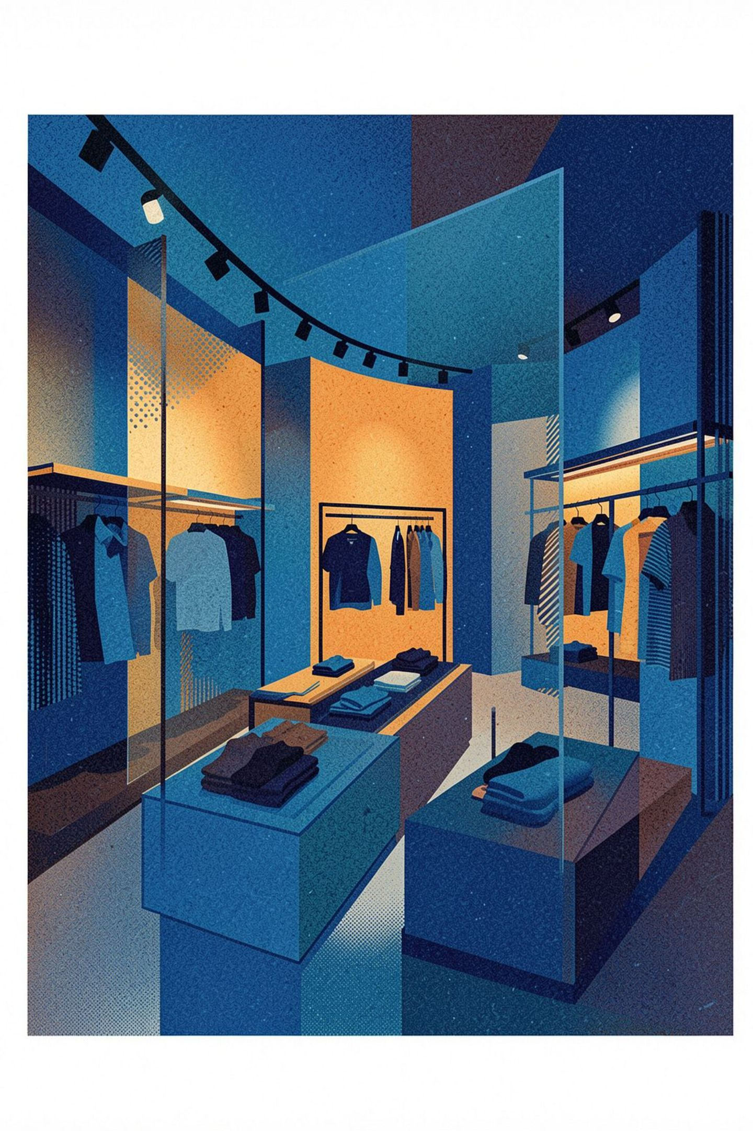
Sales Performance
Retail operations and financial performance across channels, markets, and store execution
A strategic overview of revenue, profitability, and operational performance designed to highlight the key drivers behind retail growth and set the stage for deeper analysis.

Slide 2
Executive Summary & KPI Overview
The network delivers strong baseline profitability with key performance indicators reflecting healthy operational metrics across all channels.
$12.36M
125K
Total Revenue
Units Sold
Across all channels
Total quantity moved
$7.07M
9.94%
Total Profit
Return Rate
57.26% blended margin
Within acceptable range

Slide 3


Revenue Performance
$12.36M Total Revenue
Distributed across all five retail and digital channels
$7.07M Profit Generated
Reflecting disciplined cost management network-wide
57.26% Blended Margin
High consistency across all five channels indicates a well-positioned product mix

Slide 4
Volume & Return Metrics
125,000 Units Sold
9.94% Return Rate
$98.88 Avg. Order Value
Strong unit volume reflects healthy customer demand across all product categories
Within acceptable range for retail operations — no corrective action required
Per transaction average indicating solid basket size across all channels

Slide 5
Store Channel Performance
Net revenue is distributed across five strategic channels with consistent performance metrics.
01
02
03
Lisbon Flagship
Porto Center
Faro Outlet
Primary market anchor with highest transaction volume
Northern Portugal hub serving the metropolitan area
Southern presence with highest-margin operations at 57.72%
04
05
Coimbra Boutique
Online Channel
Central market with strong customer loyalty and repeat purchases
Digital retail extending geographic reach beyond physical footprint

Slide 6
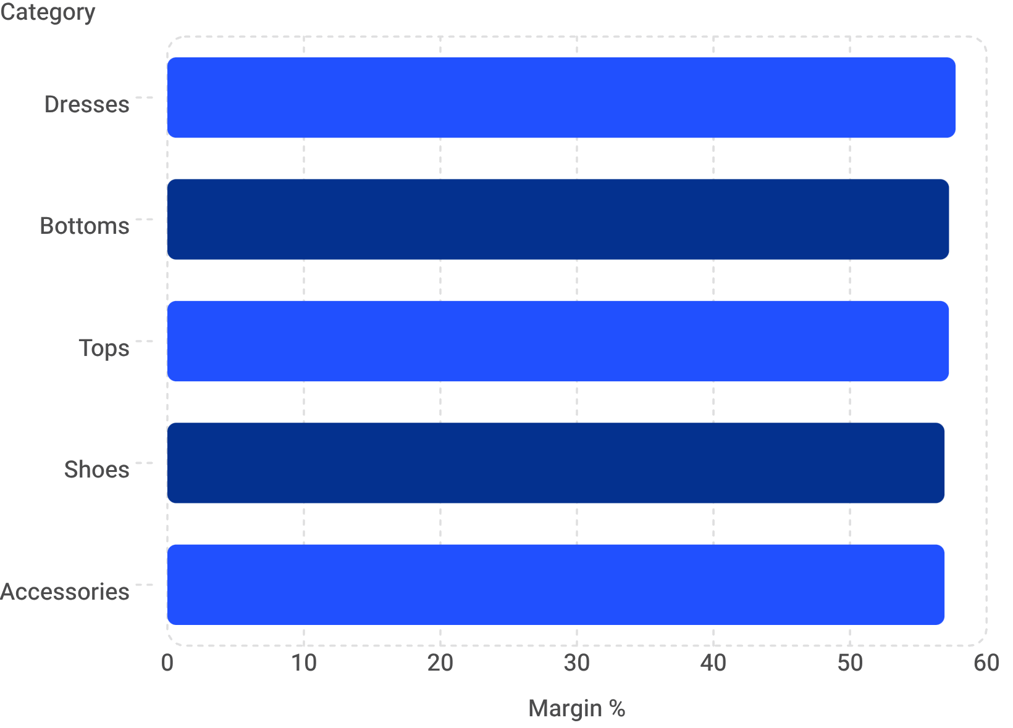
Product Category Profitability
Category Highlights
Accessories: 24,950 units — volume leader across all SKUs
Shoes: 24,661 units — strong volume performer
Dresses: Highest margin at 57.73%
Tops & Bottoms: Consistent margin at 57.24%–57.25%
Five core categories each contribute roughly $2.18M–$2.23M in revenue

Slide 7




Customer Demographics
Adults 25–45
Middle-Aged 46–60
Seniors 60+
Youth 16–24
Primary segment — 38% of net sales from 8,315 customers. Core revenue driver.
Secondary core with strong repeat-purchase behavior and high lifetime value.
Consistent segment with balanced distribution across all store channels.
Growth opportunity via digital-first engagement and online channel activation.

Slide 8


Top Geographic Markets
Lisbon — $2.23M
Highest revenue concentration; flagship market anchor
Faro — $2.16M
Strong outlet performance; benchmark margin model
Braga — $2.16M
Expansion opportunity — significant revenue without a dedicated store
Braga generates $2.16M with no physical presence — a compelling investment case.

Slide 9

Strategic Recommendations
1
Channel Efficiency
Replicate Faro's 57.72% margin model across other locations — standardize pricing and cost controls.
2
Product Mix Optimization
Prioritize Accessories & Shoes for volume; leverage Dresses for margin-led growth initiatives.
3
Customer Loyalty Program
Develop a targeted loyalty scheme for the Adults 25–45 segment to deepen the primary revenue base.
4
Geographic Investment
Focus capex on Lisbon, Faro & Braga — the three highest-ROI markets in the network.

Slide 10
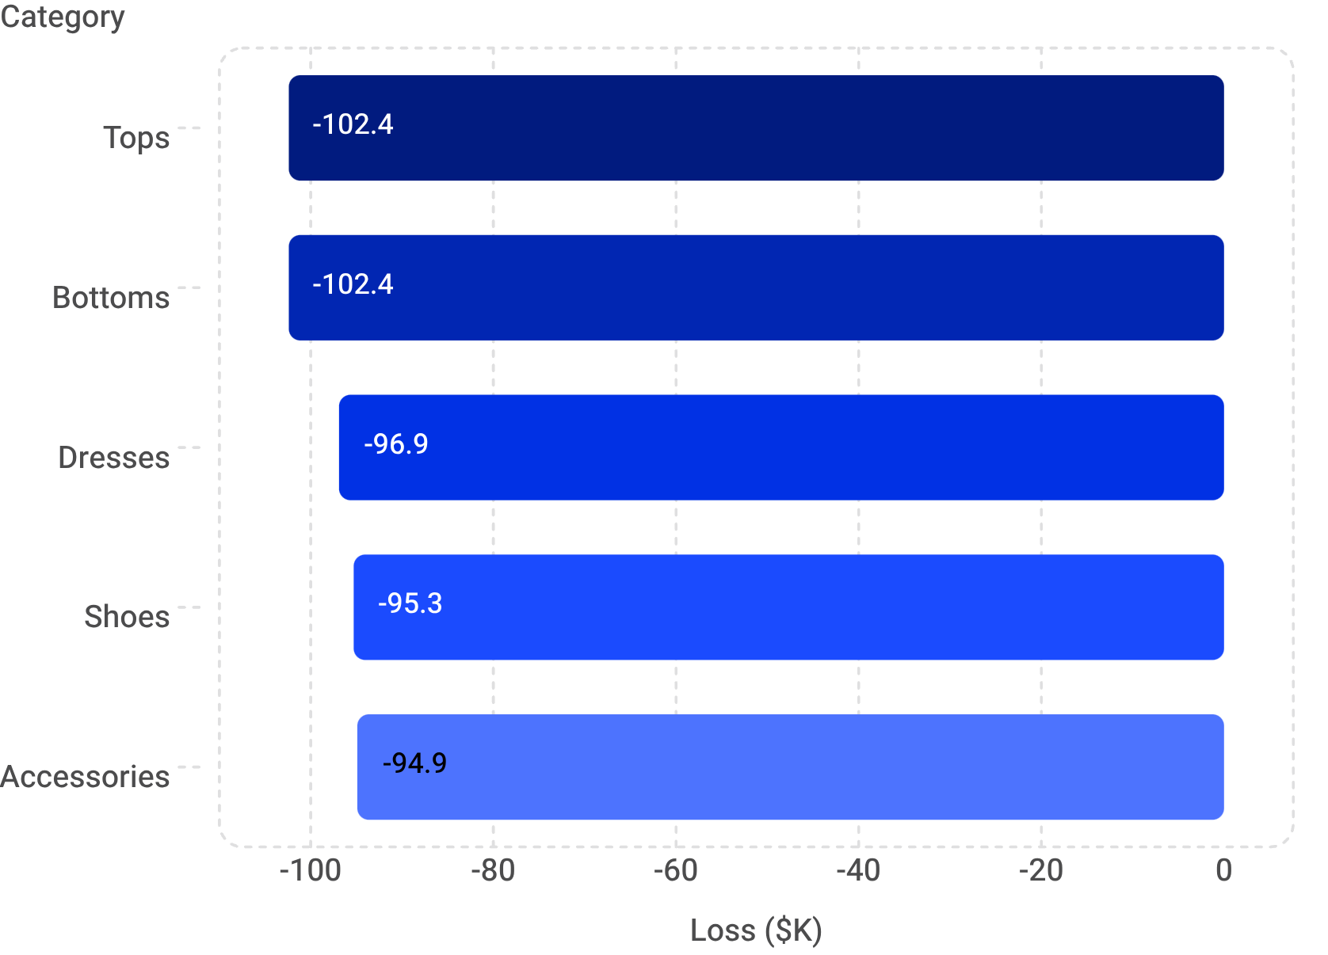
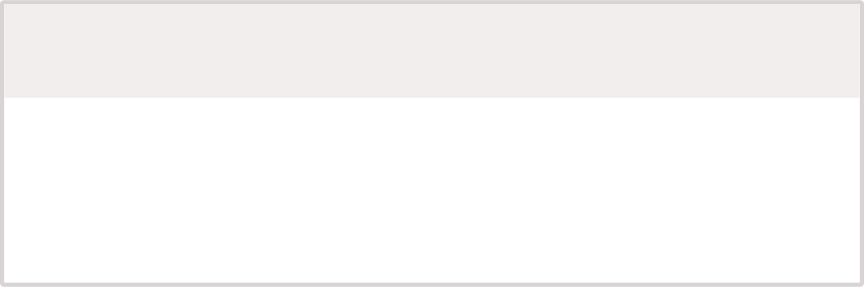
⚠️ CRITICAL: Negative-Margin Transaction Crisis — $496K Revenue Leak
8,378 negative-profit transactions account for 16.89% of all completed sales, creating a total loss of -$496,494.25.
The root cause is cost price exceeding list price for many items, further compounded by promotional discounts of 0–30% that push sales below breakeven.
1
2
Automated Pricing Guardrails
Audit Cost-Price Mapping
Implement POS and e-commerce checks that block transactions below cost.
Review every cost_price vs. list_price mapping to isolate mispriced SKUs.
3
4
Cap Promotional Discounts
Renegotiate Supplier Contracts
Limit discounts to prevent below-cost sales and margin erosion.
Prioritize high-cost SKUs where supplier terms are driving structural losses.
Structural cost-price misalignments, not isolated data errors, are creating recurring losses across categories and channels.
Channel Loss Breakdown
Porto Center — -$102.5K
Lisbon Flagship — -$101.4K
Coimbra Boutique — -$101.1K
Faro Outlet — -$97.5K
Online Channel — -$94.1K

Slide 11



Strategic Recovery Roadmap: 3-Step Mitigation Plan
SHORT-TERM (Weeks 1–4): Emergency Containment
Deploy automated pricing guardrails in POS and e-commerce platforms to block all below-cost transactions
Implement real-time cost-price validation at point of sale
Freeze all promotional discounts above 15% until pricing audit is complete
Expected impact: Prevent new negative-margin sales immediately
MEDIUM-TERM (Months 2–3): Structural Remediation
Complete full audit of cost_price vs. list_price mappings across all 8,378 affected transactions
Identify root causes: supplier cost increases, data entry errors, or catalog misalignment
Renegotiate supplier contracts for high-cost SKUs driving structural losses
Recalculate correct list prices to restore 55%+ margin targets
Expected impact: Recover $150K–$200K in margin correction
LONG-TERM (Months 4–6): Systemic Prevention
Implement automated supplier catalog feed validation to catch cost-price inversions
Establish quarterly pricing audits and margin monitoring dashboards
Create category-level discount caps tied to baseline margin thresholds
Train merchandising and procurement teams on cost-price governance
Expected impact: Eliminate recurring negative-margin transactions and stabilize profitability

